Slide 1
Lending Case Club Study
Rahul Rawat

Slide 2
AGENDA
Introduction​
Primary goals
​​Summary​

Slide 3
Introduction
Solving this assignment will give you an idea about how real business problems are solved using EDA. In this case study, apart from applying the techniques you have learnt in EDA, you will also develop a basic understanding of risk analytics in banking and financial services and understand how data is used to minimize the risk of losing money while lending to customers.

Slide 4
Primary GOAL
This company is the largest online loan marketplace, facilitating personal loans, business loans, and financing of medical procedures. Borrowers can easily access lower interest rate loans through a fast online interface.
Like most other lending companies, lending loans to ‘risky’ applicants is the largest source of financial loss (called credit loss). Credit loss is the amount of money lost by the lender when the borrower refuses to pay or runs away with the money owed. In other words, borrowers who default cause the largest amount of loss to the lenders. In this case, the customers labelled as 'charged-off' are the 'defaulters

Slide 5
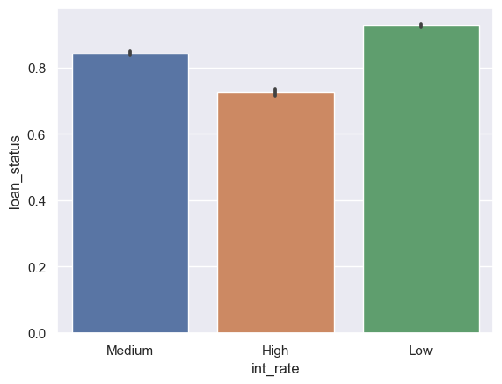
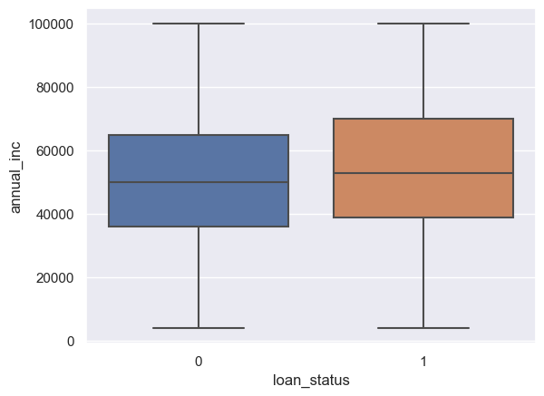
Loan Defaulters By Interest Rates
Data it seems like Medium to High interest rate drives a factor for a customer to not repay loan to company.
Loan Defaulters By Salary
1 – Indicates, Customer Paid successfully
Indicates , Customer Charged Off
This is per customer annual income and its evident , lower salary customer are most likely to get charged off

Slide 6
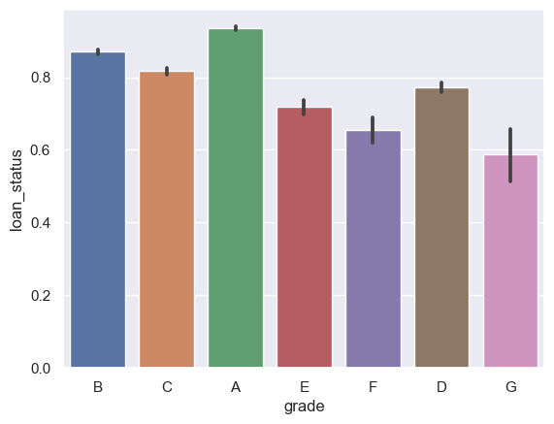
Loan Defaulters By GRADES
Grade G,F and E type of customer are most likely type of customer who are not able to repay loan

Slide 7
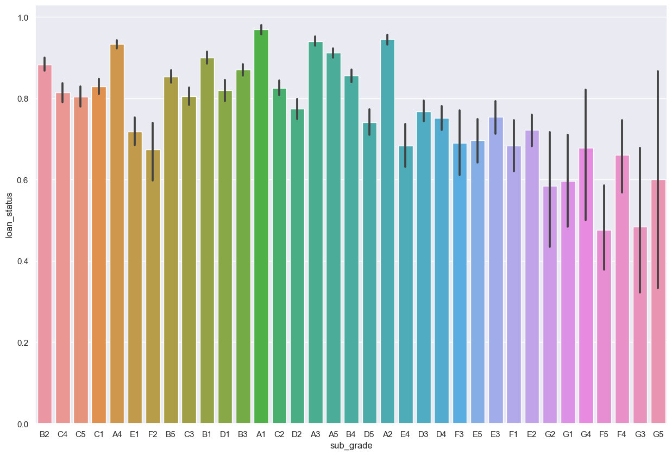
Loan Defaulters By SUB-GRADES
Sub Grade G3,F5 are type of customer are most likely type of customer who are not able to repay loan

Slide 8
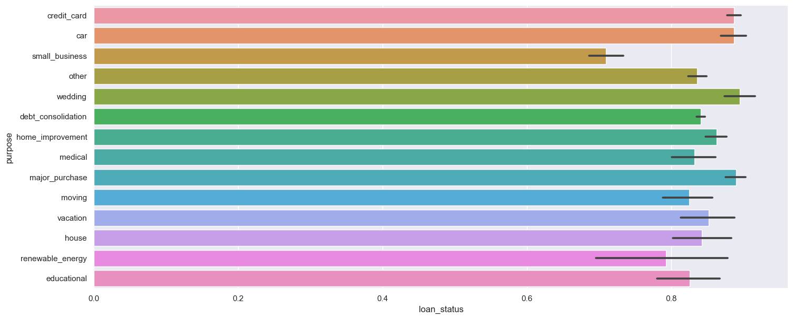
Loan Defaulters By Purpose
From Data, it seems like Small business purpose are in charged off for about 30%
Wedding type of loans are recovered 90-95%.

Slide 9
SUMMARY
At Lending Case Study, We have identified below are the drivers for a loan defaulter
Interest Rate
Salary
Grade
Subgrade
Purpose

Slide 10
THANK YOU
Rahul Rawat

